Slide 1

Hey Curious People!
Welcome to Curious Ecosystem, The #1Product Development
Curious Developers

Slide 2

Today’s Schedule
TOPIC
Welcome Note
Introduction
Timeline
About Mentor Mentee and Mission
Github Workflow & Delign Validation
Queries, & Suggestions
Curious Developers

Slide 3
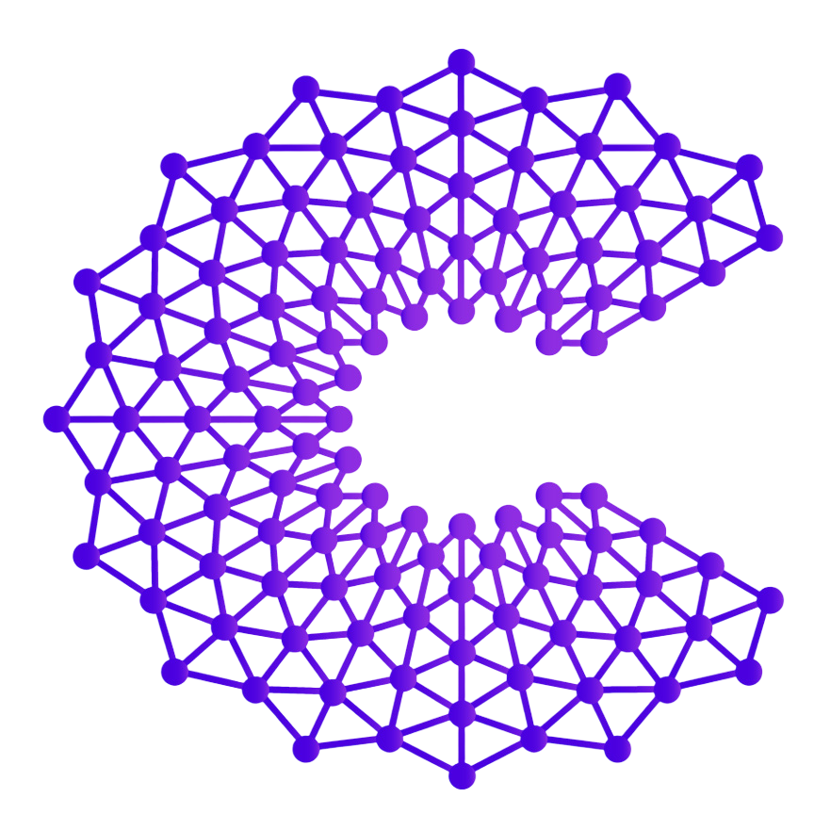

Curious Ecosystem
Curious Developers Community
Curious Ecosystem
Trinahva Organic Products
Curious Developers

Slide 4
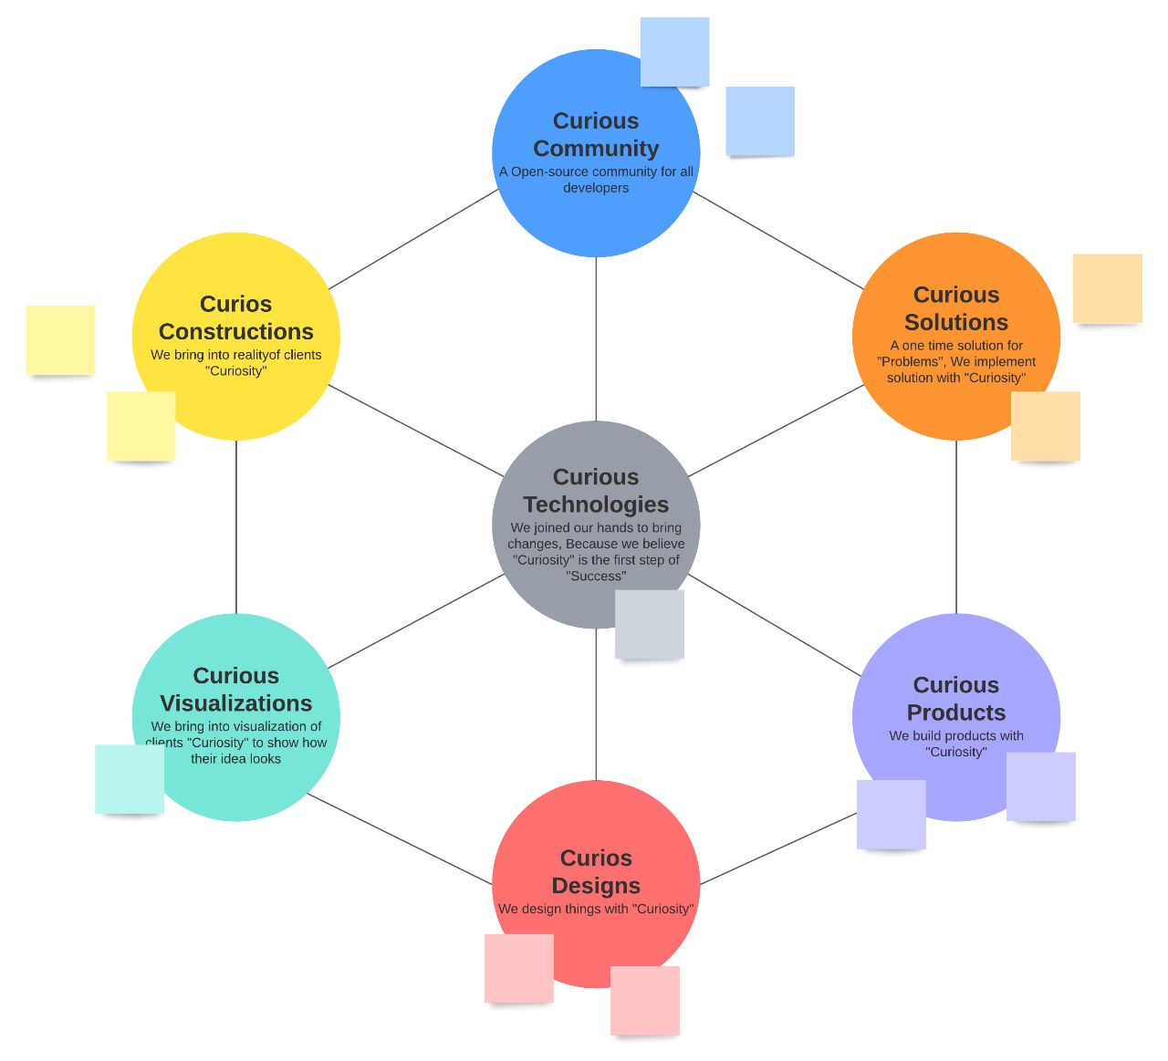
Curious Subsidiaries
Curious Developers

Slide 5

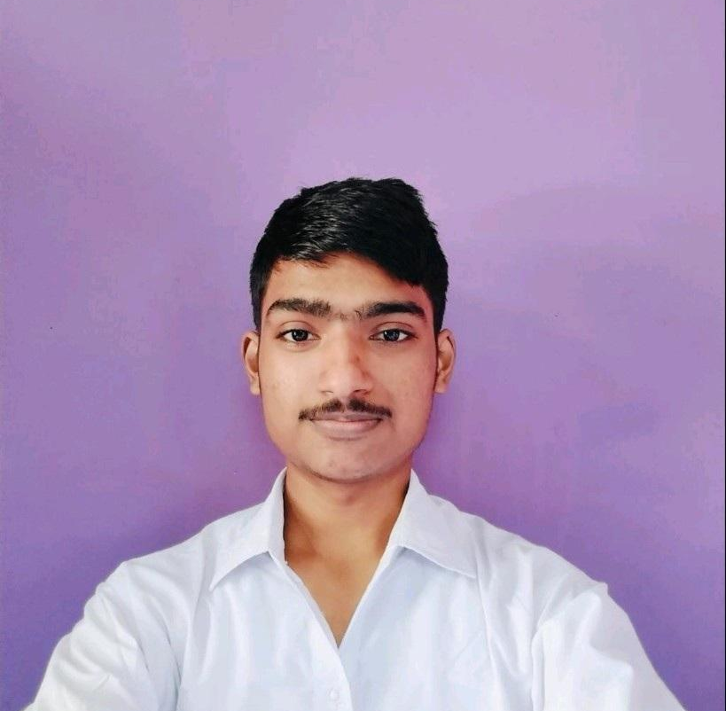
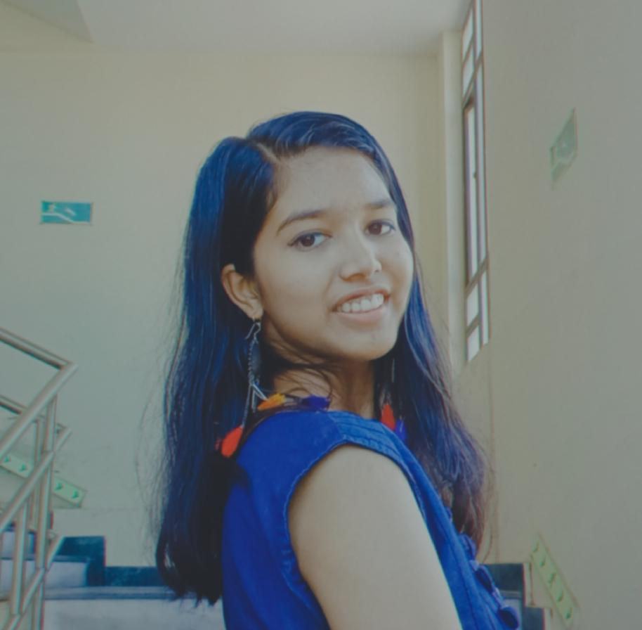

Initiators
Nandan GN
Lead at CDC
Aayush Agarwal
Lead at CDC
Kajal Lanjhiyana
Lead at CDC
Shanvi Shukla
Lead at CDC
Curious Developers

Slide 6
Thought Of The Day
“People work better when they know what the goal is and why it is important .”
Curious Developers

Slide 7

Know
What is mentor mentees connect?
Curious Developers

Slide 8

Our Vision
“The mission of Mentor-Mentees connect is to bridge the gap between students and mentors, providing a supportive environment that enables students to flourish academically and professionally. Our vision is to create global community where knowledge and guidance are easily accessible, inspiring the next generation of leaders and innovators.”
Curious Developers

Slide 9
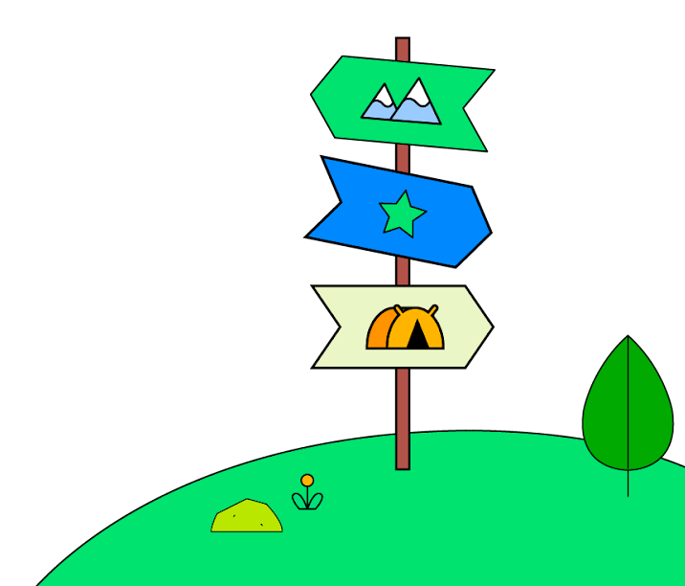
Agenda
Give Little brief about CDC & Mentor Mentee
Highlighting about Open Source Development
GitHub Workflow
Design Prototype Discussion
Collecting Users To Onboard Into GitHub Organization
Feedback and Input
Curious Developers

Slide 10

Session Roadmap
1
2
3
4
5
Item #1
Brief
Item #2
About OSPD
Item #3
GitHub Workflow
Item #4
Design Discussion
Item #5
Onboarding Users
Briefing about Curious Developers Community and New Open Source Product Mentor and Mentee Connect
Highlighting about Opsource Product Development and its benefits for individuals
Github Workflow How A Product is going to be developed using Git & GitHub?
Prototype demonstration and asking feedback on it
Interested people onboarding to GitHub Organisation and divided into multiple groups with 2 leads in each
Curious Developers

Slide 11
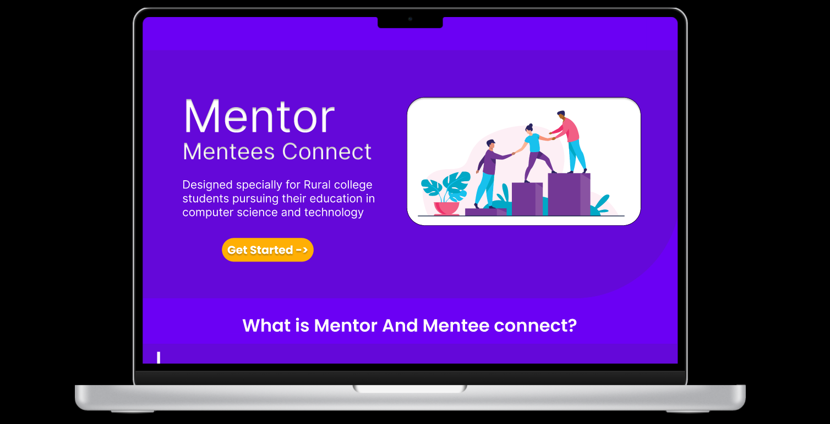

Start

